Slide 1



Applying Factor Analysis with cluster-then-label Semi-supervised Learning Approach in Classification Problems
Kaggle Days Meetup Delhi NCR
05th December, Delhi
Caesar Lupum, Crislânio Macêdo

Slide 2
A brief overview ...
Semi-Supervised learning (SSL)
Basic Concept
Cluster-then-label Semi-supervised Learning Approach
Factor Analysis (FA)
First Notable mention
Basic Concept
Applications
Factor Analysis Model
Statistics Associated with Factor Analysis
Conducting Factor Analysis
Demo
Problem
Pipeline modeling FA
Pipeline modeling FA+SSL

Slide 3

WHOIAM?
> Crislânio Macêdo
> Majored in Computer Science from Universidade Federal do Ceará
and Mastering Degree from Universidade Estadual do Ceará.
> Kaggle Notebook Master
How to reach me:
LinkedIn:/crislanio
Kaggle:/caesarlupum
GitHub: @crislanio
Medium: @crislanio.ufc
Twitter: @crs_macedo

Slide 4
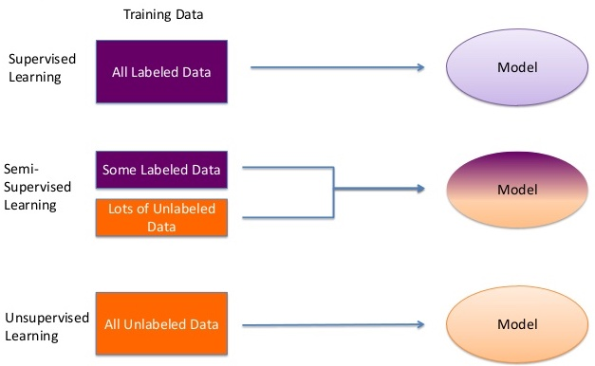
Semi-Supervised learning (SSL)-Basic Concept
Semi-supervised learning is a class of machine learning tasks and techniques that also make use of unlabeled data for training – typically a small amount of labeled data with a large amount of unlabeled data

Slide 5
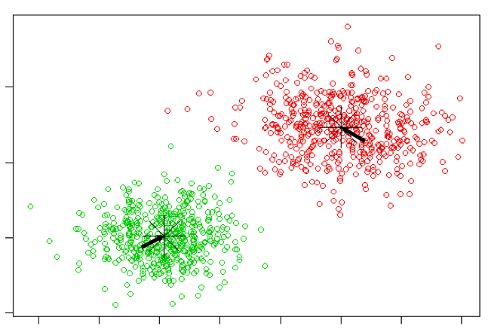
Semi-Supervised learning (SSL)- Cluster-then-label Semi-supervised Learning Approach
Intra-cluster distances are minimized.
Inter-cluster distances are maximized.

Slide 6
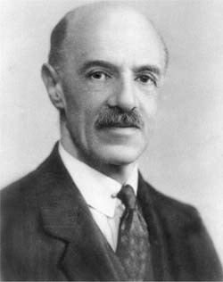
Factor Analysis - First Notable mention
Charles Edward Spearmen was known for his seminal work on testing
and measuring of HUMAN INTELLIGENCE by using the
FACTOR ANALYSIS during World War I.
CHARLES EDWARD SPEARMEN
(BRITISH PSYCHOLOGIST)
Factor analysis is usually dated from Charles Spearman’s paper ‘General Intelligence’ Objectively Determined and Measured published in the American Journal of Psychology in 1904

Slide 7
Factor Analysis - Basic Concept
What is factor analysis?
Factor analysis is used:
To identify underlying dimensions, or factors, that explain the correlations among a set of variables.
To identify a new, smaller, set of uncorrelated variables to replace the original set of correlated variables.

Slide 8
Factor Analysis - Basic Concept
Advantages
Disadvantages

Slide 9
Factor Analysis - Basic Concept
Why Factor Analysis?
Testing of theory
Explain covariation among multiple observed variables by
Mapping variables to latent constructs (called “factors”)
Understanding the structure underlying a set of measures
Gain insight to dimensions
Construct validation (e.g., convergent validity)

Slide 10
Factor Analysis - Applications
In physical and biological sciences
geochemistry, hydrochemistry, ecology, molecular biology
Factor analysis can be used for summarizing high-density oligonucleotide(short DNA or RNA molecules) DNA microarrays
Market Segmentation
Achievement in education
Diagnostic criteria in mental health
Personality and cognition in psychology
source: https://en.wikipedia.org/wiki/Factor_analysis

Slide 11
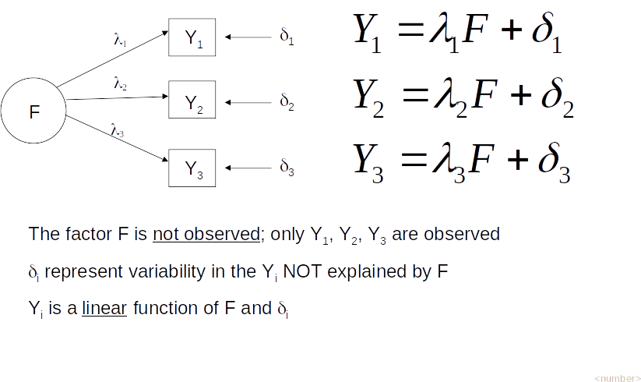
Factor Analysis - Factor Analysis Model

Slide 12
Statistics Associated with Factor Analysis
Communality. Amount of variance a variable shares with all the other variables. This is the proportion of variance explained by the common factors.
Eigenvalue. Represents the total variance explained by each factor.
Factor loadings. Correlations between the variables and the factors.
Factor matrix. A factor matrix contains the factor loadings of all the variables on all the factors
Factor scores. Factor scores are composite scores estimated for each respondent on the derived factors.
Kaiser-Meyer-Olkin (KMO) measure of sampling adequacy. Used to examine the appropriateness of factor analysis.

Slide 13
Statistics Associated with Factor Analysis
Bartlett's test of sphericity. Bartlett's test of sphericity is used to test the hypothesis that the variables are uncorrelated in the population (i.e., the population corr matrix is an identity matrix)
Correlation matrix. A correlation matrix is a lower triangle matrix showing the simple correlations, r, between all possible pairs of variables included in the analysis. The diagonal elements are all 1.
Percentage of variance. The percentage of the total variance attributed to each factor.
Scree plot. A scree plot is a plot of the Eigenvalues against the number of factors in order of extraction.

Slide 14
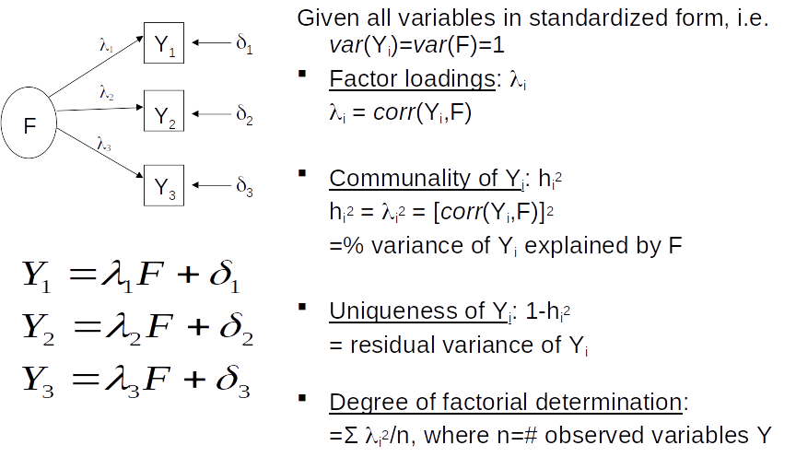
Factor Analysis - Factor Analysis Model
Notes:
this is a One Common Factor Model Interpretation. for example the communality is H2. % variance of Yi, exaplaned by f.

Slide 15
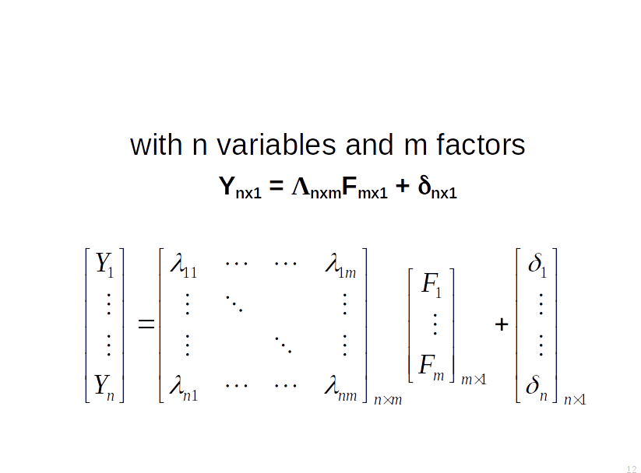
Factor Analysis - Matrix Notation
Notes:
The factor pattern matrix:
columns represent derived factors
Rows represent input variables
Loadings represent degree to which each of the variables “correlates” with each of the factors
Loadings range from -1 to 1
Inspection of factor loadings reveals extent to which each of the variables contributes to the meaning of each of the factors.
High loadings provide meaning and interpretation of factors (~ regression coefficients)

Slide 16

Demo - RETAIL CASE
You are responsible for the analysis that will serve as a foundation for the strategy of entering the Brazilian market of a large multinational retailer in the supermarket sector.
task 1: Classify Brazilian municipalities based on the available information
task 2: Develop a classification model to calculate the probability that a given municipality belongs to one of the groups created.
Which groups of municipalities should be the gateway to a company in the country? Why?
source
🛍️ Retail Case - SSL+FA: https://www.kaggle.com/caesarlupum/retail-case-ssl-fa/

Slide 17
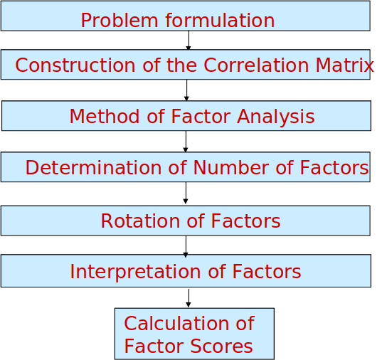
Demo - Conducting Factor Analysis

Slide 18
Demo - SSL+ FA
Labeling data with Cluster Approach
Validation of Classification
Use FA scores for interpreting new entries
Apply FA in entire data
Use FA scores for interpreting clusters

Slide 19
References and resources
Types of learning
Factor analysis
FA in psychometrics
Retail Case SSL +Factor Analysis

Slide 20


Slide 21
Applying Factor Analysis with cluster-then-label Semi-supervised Learning Approach in Classification Problems
Kaggle Days Meetup Delhi NCR
05th December, Delhi
Caesar Lupum, Crislânio Macêdo

